Slide 1


Automatic Alcohol Detection & Engine Lock System Using GPS and IoT
Presented by
1. Antony Pearlson Jeyam .J (711621106001)
2. Elavarasi . K (711621106007)
3. Micheal Beavin .JR (711621106021)
Guided by
Mrs. M. THAMARAISELVI
ASSISTANT PROFESSOR
DEPARTMENT OF ECE
KATHIR COLLEGE OF ENGINEERING.
04-02-2025
Batch : 3

Slide 2
Presentation Outline
  Introduction
  Abstract
  Literature Survey
  Problem Statement
  Proposed Block Diagram
  References
04-02-2025
Batch : 3

Slide 3
Introduction
Alcohol consumption is a common part of many traditions and celebrations, but even small amounts can impair perception and reaction time, increasing the risk of drunk driving accidents. Driving under the influence is a leading cause of road crashes, resulting in injuries, fatalities, and legal consequences. To prevent this, strict blood alcohol limits are enforced, emphasizing the need for reliable alcohol detection systems to enhance road safety and promote responsible driving.
DOMAIN : EMBEDDED SYSTEM & IOT
Description:
  This project falls under the Embedded Systems and IoT domain, as it integrates hardware components like Arduino Uno, sensors, relays, and communication modules with IoT-based monitoring and control mechanisms.
  Road Safety Systems: Prevents drunk driving accidents.
  Smart Vehicles: Enhances security by integrating IoT-based monitoring.
  Fleet Management: Used in commercial transport for safety monitoring.
04-02-2025
Batch : 3

Slide 4
Abstract
Driving under the influence of alcohol is a leading cause of road accidents, posing a significant risk to public safety. To mitigate this risk, an automated alcohol detection and vehicle control system is proposed. This system utilizes an Arduino Uno (ATMEGA328P) microcontroller integrated with an alcohol sensor to monitor the driver's alcohol level.
If the sensor detects alcohol above a predefined threshold, the system performs the following actions:
Displays a warning.
Restrict the vehicle's engine speed.
Sends an alert to a mobile.
Tracks and shares the vehicle’s location.
04-02-2025
Batch : 3

Slide 5
Literature Survey
Paper details | Journal details | Methodology (Algorithm, Technique, Specific Domain ) | Advantages | Disadvantages
"Alcohol Detection-Based Engine Locking System with GPS“ Year : 2024 “Driver Alcohol Detection System Based on Virtual Instrumentation”​ Year : 2018 | Journal of Management & Entrepreneurship, UGC Care Group I IFAC PapersOnline | Uses Arduino UNO, Seat Belt Sensor, MQ3 Alcohol Sensor and GPS The proposed system halts the engine and alerts users via buzzers Developed using LabVIEW with Arduino-Compatible Compiler (ACCL). It measures Breath Alcohol Concentration (BrAC) to control ignition. It integrates virtual instrumentation for flexibility​ | Comprehensive safety with real-time monitoring of multiple risk factors Flexible software integration allows for further customization​ | Potential sensor inaccuracies or false positives. LabVIEW's Arduino compiler supports limited hardware and data handling, restricting scalability​
04-02-2023
Batch : 3

Slide 6
Literature Survey
Paper details | Journal details | Methodology (Algorithm, Technique, Specific Domain ) | Advantages | Disadvantages
3. "Alcohol Detection Using Arduino with Motor Locking“ Year : 2022 ​ 4.Automatic Engine Lock System Through Alcohol Detection in Virtual Environment Year : 2022 Authors:Ipseeta Nanda, Rajesh De. | Journal of Engineering Technology Information Management and Computer Science (IMCS), Vol. 5, No. 1 | MQ3 Alcohol Sensor Arduino Mega Microcontroller DC Motor to lock engine Buzzer Utilizes an Arduino Uno microcontroller (ATmega328) to control a motor driver, alcohol sensor (MQ3), buzzer, and GSM/GPS modules. | Simple hardware setup with effective alcohol detection and motor-locking capabilities. Easy to implement; reduces accidents by disabling engines for intoxicated drivers. | High Cost compared to others. Software price is high.
04-02-2025
Batch : 3

Slide 7
Literature Survey
Paper details | Journal details | Methodology (Algorithm, Technique, Specific Domain ) | Advantages | Disadvantages
5. Development of Alcohol Triggered Vehicle Engine Lock System Year : 2019 Authors:Ighalo Joshua, Uzairue Stanley, et al. 6. Experimental Analysis of Alcohol Detection in Open and Closed Vehicles Year : 2019 Authors :Mahesh Buradkar, Amit Sanjay Girpunje, et al.. | International Journel of Robotics andAutomation, Vol 8,No. 1 International Journal of Advanced Research in Science, Communication and Technology Vol. 2 | Employs the breathalyzer sensor integrated with Arduino Uno and ATmega328 PU microcontroller. Focuses on experimental testing with MQ3 sensors in open and closed vehicles.Alcohol thresholds are set (e.g., 1.20% concentration) | Provides a real-time display of alcohol level. Tested in different environments (open and closed vehicles), highlighting sensor accuracy. | Sensor misreading due to ethanol sources other than alcohol Open vehicle testing is less reliable due to environmental factors like temperature and humidity; requires more robust calibration for real-world usage​
04-02-2025
Batch : 3

Slide 8
Literature Survey
Paper details | Journal details | Methodology (Algorithm, Technique, Specific Domain ) | Advantages | Disadvantages
7. Alcohol Detection and Engine Locking System Year : 2022 Authors:Nookala Venu, Vamshi M, Akhil V, Deepika K, Prashanth K, Raffiudhin M | International Journal of Engineering Trends and Technology | Uses an MQ3 alcohol sensor integrated with Arduino Uno microcontroller. Based on the alcohol concentration, the system warning alarm (buzzer). | Prevents drunk driving by locking the engine. | The system relies heavily on proper installation and calibration for accuracy.
04-02-2025
Batch : 3

Slide 9
Comparative Analysis
Reference | Microcontroller | Alcohol Sensor | Classification Accuracy | Real-World Deployment | Energy Efficiency | Limitations & Challenges
Alcohol detection using Arduino with motor locking | Arduino Mega | MQ-3 Alcohol sensor | 80-90 % | Yes | High | Face lock & fingerprint authentication recommended
Automatic Engine Lock System Through Alcohol in VE | Arduino Uno | MQ-3 Alcohol sensor | 80-90 % | No | Low | GPS & GSM module for location tracking
Alcohol Detection based Engine Locking System with GPS | Arduino Uno | MQ-3 Alcohol sensor | 80-90 % | Yes | Moderate | Seatbelt sensor, accident detection, LCD display
Development of alcohol triggered vehicle | Arduino Uno | breathalyzer Sensor | 70-80% | Yes | Moderate | LCD for real-time feedback
Experimental Analysis of Alcohol Detection in Open and Closed Vehicle | Arduino Uno | MQ-3 Alcohol sensor | 80-90 % | Yes | High | Open vs. closed vehicle testing
Alcohol Detection and Engine Locking System | Arduino Uno | MQ-3 Alcohol sensor | 80-90 % | Yes | High | Steering wheel sensor, emergency siren
04-02-2025
Batch : 3

Slide 10
Problem Statement
Issue:
Drunk driving is a major cause of road accidents, leading to injuries, fatalities, and property damage.
Limitations of Existing Solutions:
Most alcohol detection systems either shut down the engine completely or only alert the driver, which may not be practical in certain driving conditions (e.g., highways or heavy traffic).
Proposed Solution:
  Implement an alcohol detection-based speed control system that monitors the driver's alcohol consumption before or during driving.
  Instead of shutting down the engine, the system limits the vehicle’s speed to a predefined safe threshold to prevent reckless driving.
Key Benefits:
  Enhances road safety by reducing high-speed crashes caused by intoxicated drivers.
  Maintains vehicle control, allowing the driver to move to a safe location instead of being stranded.
  Provides a more practical approach to alcohol-impaired driving without completely disabling the vehicle.
04-02-2025
Batch : 3

Slide 11

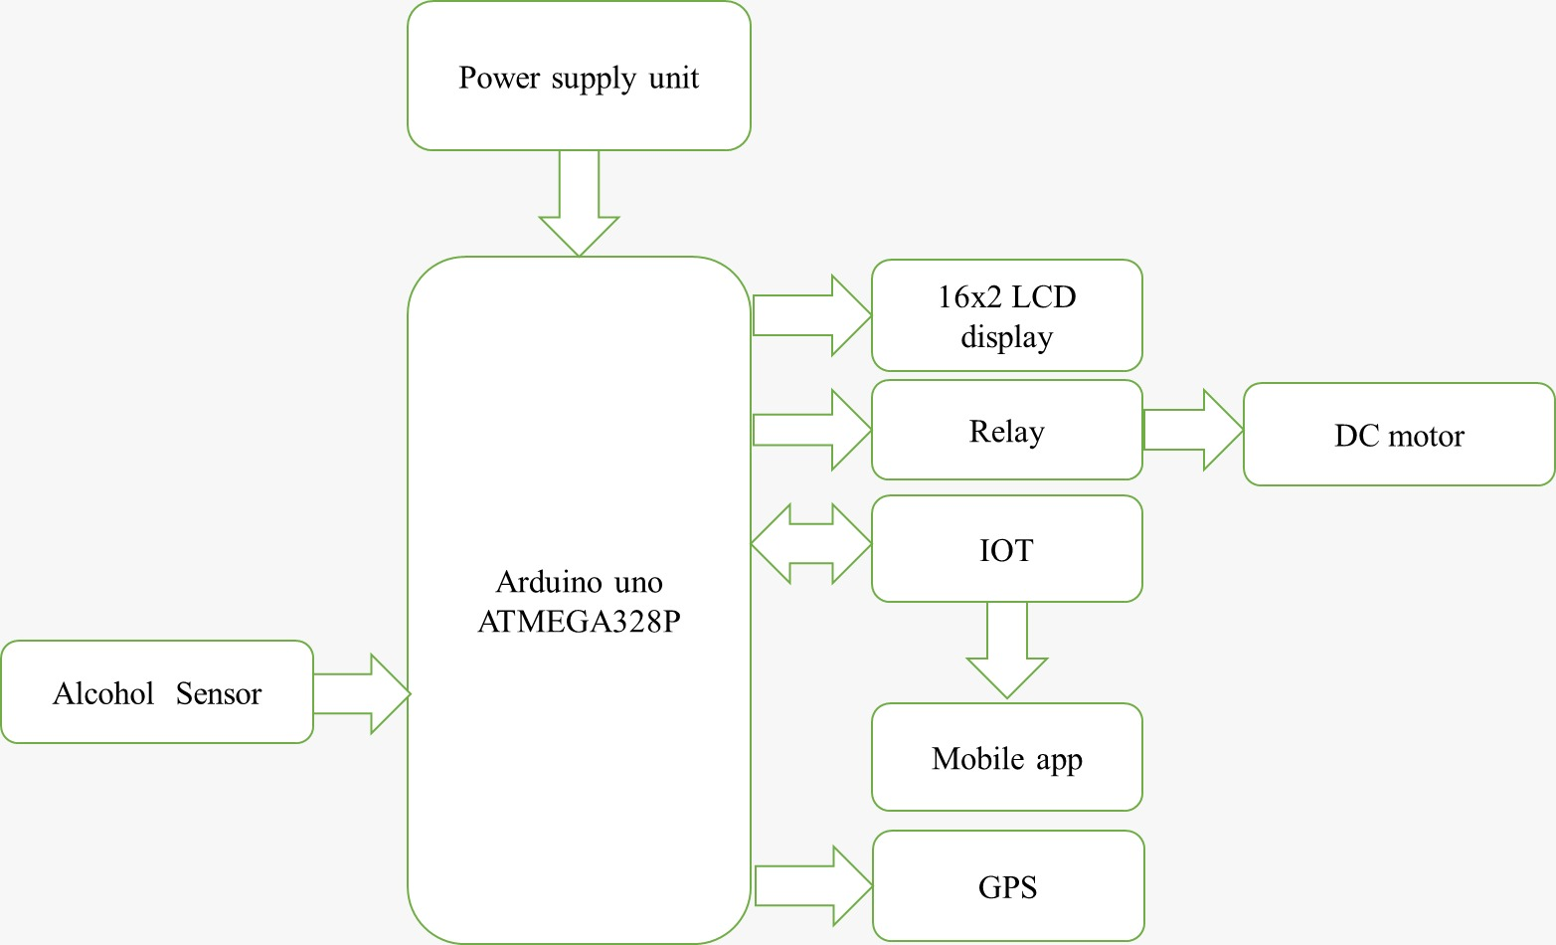
Proposed Block Diagram
30-10-2024
Batch : 3

Slide 12
References
Nanda, I. and De, R., 2022. Automatic Engine Lock System Through Alcohol Detection In Virtual Environment. Information Management and Computer Science (IMCS), 5(1), pp.23-27.
Hebsur, A.R., Madhusri, E., Gudur, M.V. and Pawar, R.V., 2024, August. Alcohol Sensing with Engine Locking System and Communication Using GPS GSM Technology. In 2024 2nd International Conference on Networking, Embedded and Wireless Systems (ICNEWS) (pp. 1-6). IEEE.
Joshua, I., Stanley, U., Charles, O., Peter, A. and Okokpujie, K., 2019. Development of alcohol triggered vehicle engine lock system. IAES International Journal of Robotics and Automation (IJRA), 8(1), p.68.
Hamamy, F. and Adib, A., 2022. Alcohol detection using Arduino with motor locking. Journal of Engineering Technology, 10(1), pp.103-109.
Nanda, I. and De, R., 2022. Automatic Engine Lock System Through Alcohol Detection In Virtual Environment. Information Management and Computer Science (IMCS), 5(1), pp.23-27.
Akshaya, H., Kumar, A.M., Reddy, A., Dhanalakshmi, D., Hariharan, S. and Kukreja, V., 2023, November. Ensuring Automobile Safety by Improved Ignition Locking System Through Blood Alcohol Content Measurement and IoT. In 2023 7th International Conference on Electronics, Communication and Aerospace Technology (ICECA) (pp. 1318-1323). IEEE.
Amala, M.C., Sanjay, S.D., Kiranmai, K., Silpa, A., Srivalli, A. and Shankar, K.B., DESIGNING AN AUTOMATIC ENGINE LOCKING SYSTEM THROUGH ALCOHOL DETECTION USING ARDUINO.
30-10-2024
Batch : 3

Slide 13


30-10-2024
Batch : 3

